Slide 1
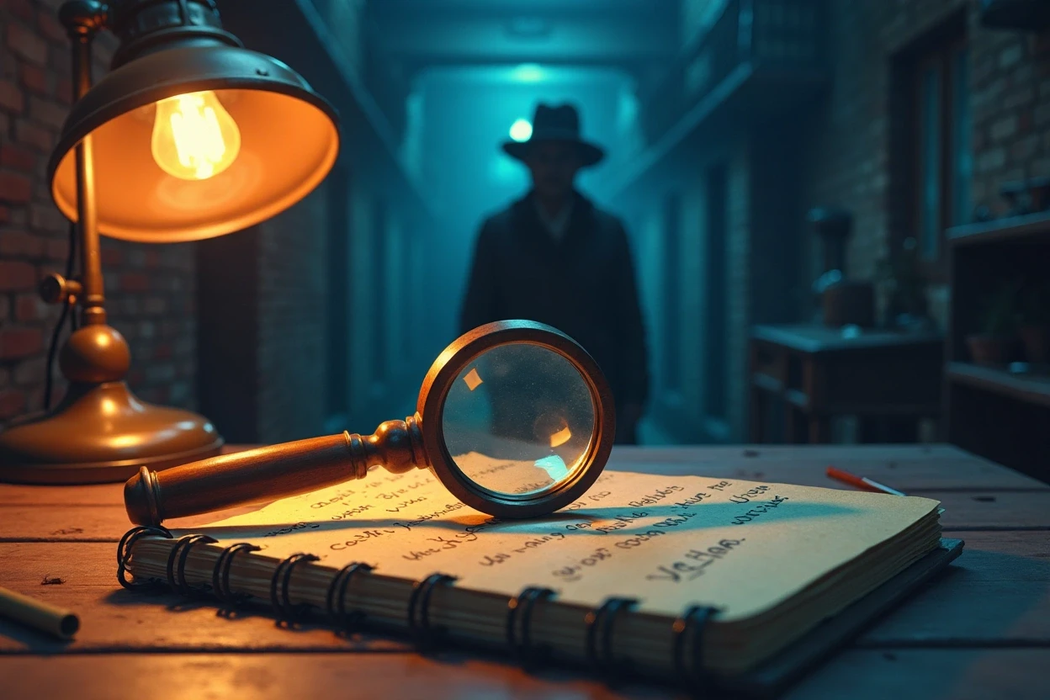


Mystery/Detective Story Presentation

Slide 2
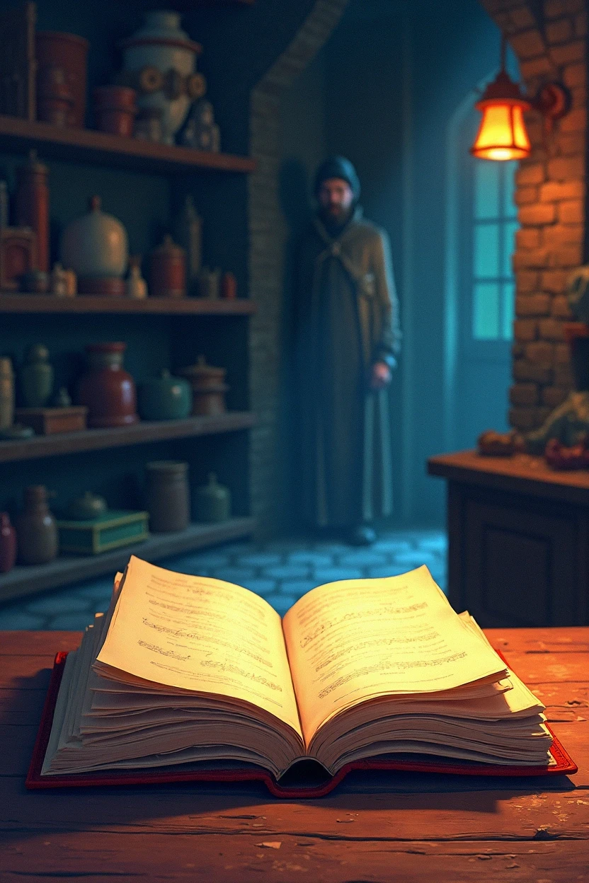

Introduction to the Mystery
The story begins with a peculiar event that catches the attention of our main character.
Something valuable has gone missing, and curiosity sparks an adventure.

Slide 3


Main Character
Detective Introduction
Meet our young detective, Alex, who loves solving puzzles.
Alex has a keen sense of observation and is always ready for a challenge.

Slide 4


Setting
Where the story happens
This story takes place in a small town with charming streets and hidden corners.
Key locations include a mysterious school, a local park, and a bustling marketplace.

Slide 5


The Mystery
What went missing or the crime
A prized trophy from the school’s annual competition has disappeared.
The trophy was last seen in the school’s trophy case before the big event.

Slide 6


First Clues
Discovery and hints
Alex discovers strange footprints near the trophy case.
A note with a riddle is found, leading to the first hint about the thief.

Slide 7


Investigation
Following the leads
Alex interviews fellow students and teachers to gather more information
Clues lead to different suspects, creating excitement and suspense.

Slide 8
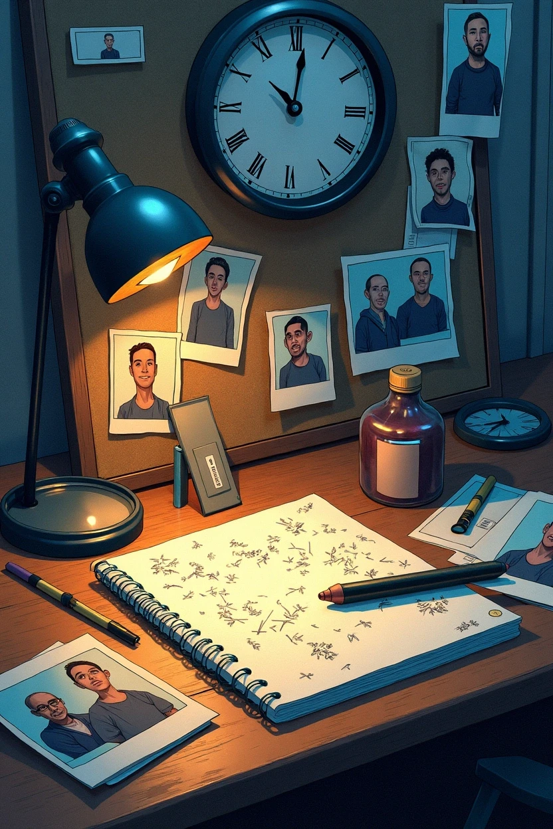

Challenges
Obstacles in solving the mystery
Alex faces challenges such as red herrings and misleading information.
Time is running out, and pressure builds to solve the case before the event.

Slide 9


Challenges
Obstacles in solving the mystery
The twist reveals that the culprit is someone Alex least expected.
A thrilling confrontation happens, leading to a surprising revelation.

Slide 10


Resolution
Mystery solved
With quick thinking, Alex retrieves the trophy and reveals the true story behind its disappearance.
The community celebrates the detective's bravery and cleverness.

Slide 11
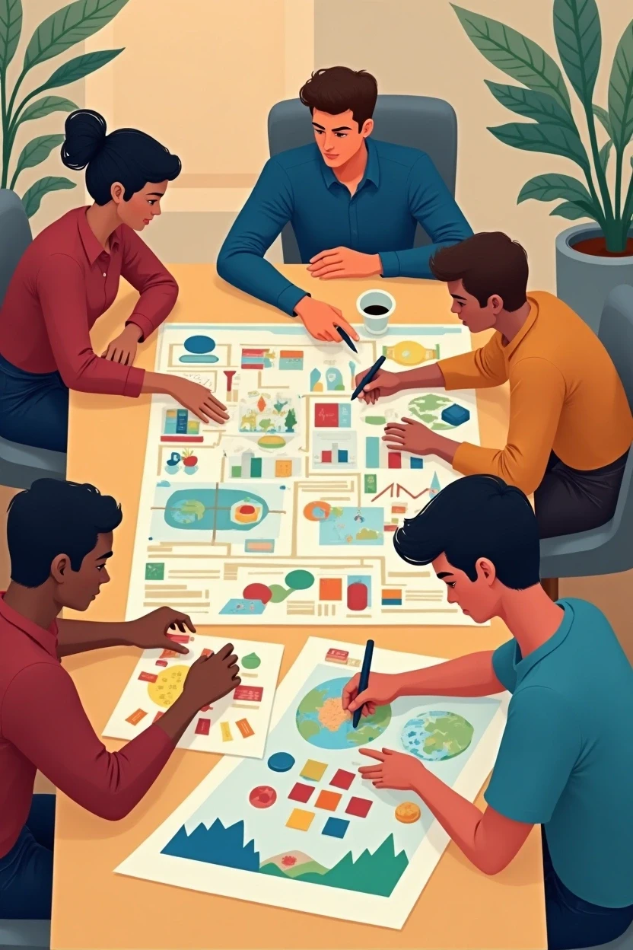

Conclusion
Moral or lesson learned
The experience teaches the importance of teamwork, trust, and believing in oneself.
Alex plans future adventures, eager for the next mystery to solve.

Slide 12


Thank You

